Slide 1
Quiz recap
CS5710: Lecture 11

Slide 2
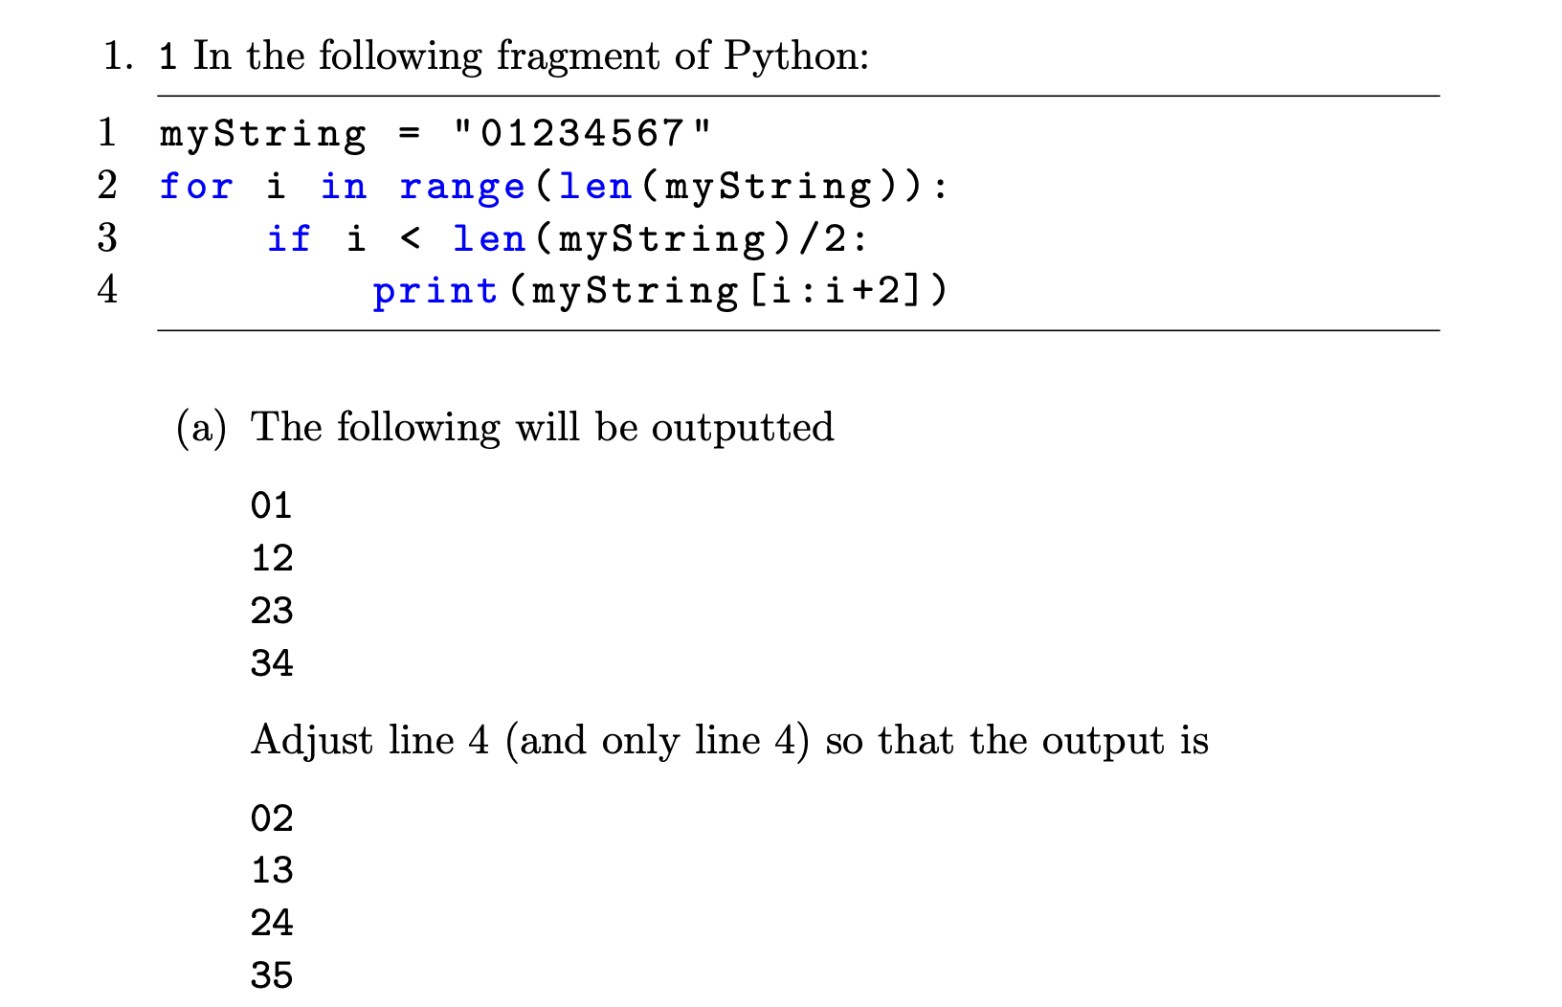
Question 1a
print(myString[i:i+3:2])

Slide 3
Question 1B
myString = “01234567”
while i < len(myString):
if i < len(myString)/2:
print(myString[i:i+2])
myString = “01234567”
i=0
while i < len(myString):
if i < len(myString)/2:
print(myString[i:i+2])
i+=1

Slide 4
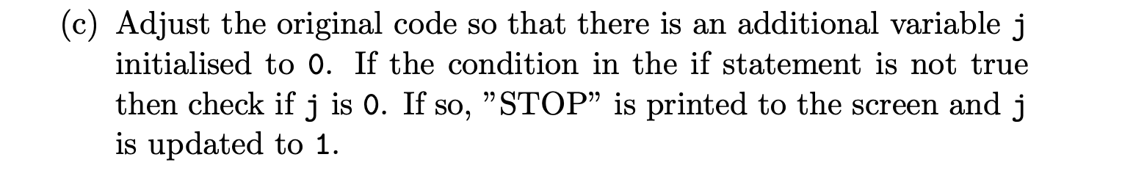
Question 1c
myString = “01234567”
j=0
for i in range(len(myString)):
if i < len(myString)/2:
print(myString[i:i+2])
elif j==0:
print(“STOP”)
j=1
What does this print?

Slide 5
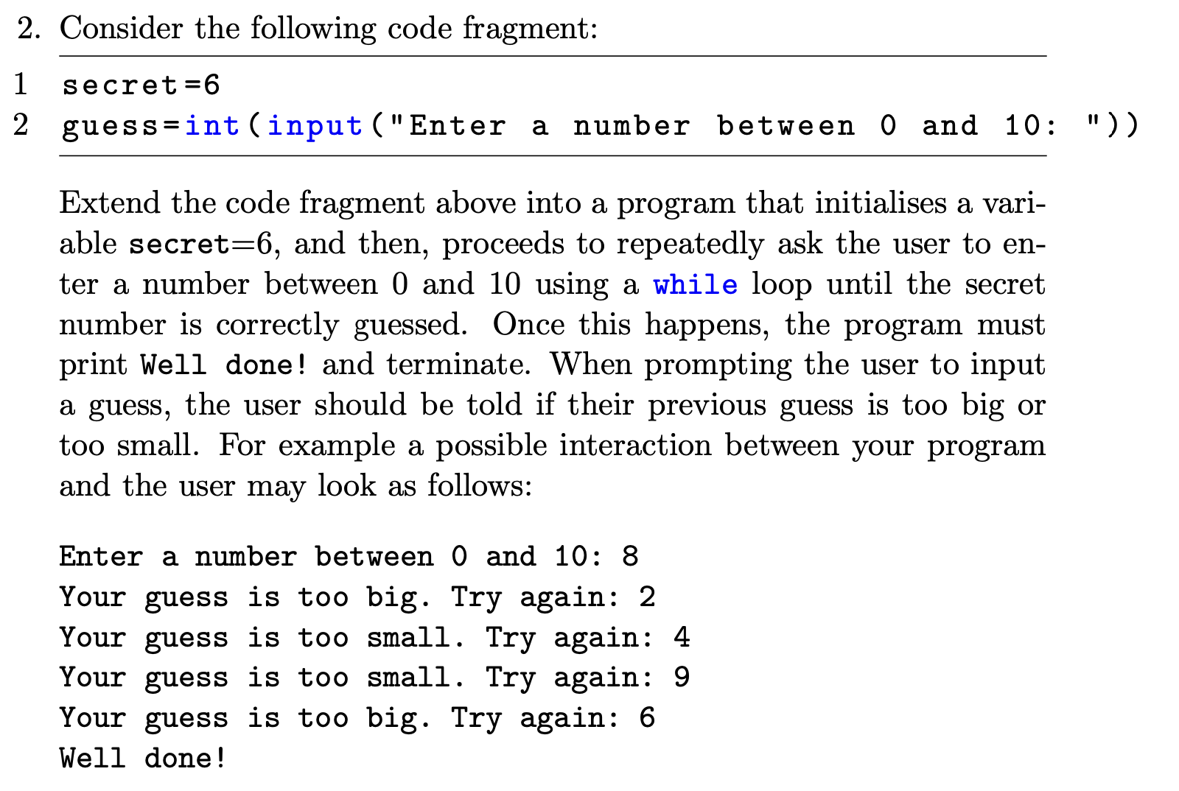
Question 2
Similar to lab exercise.
Condition in while loop can either be: a) while guess!=secret b) while True:
Also need an if statement to print out the correct message: Your guess is too big / Your guess is too small.

Slide 6
Question 3a
First you need to remember how to define a function:
There are multiple ways to implement the required functionality.
String slicing is very concise
def R4(s):
return
s[3::-1]
print(R4(“abcdef”))
“dcba”

Slide 7
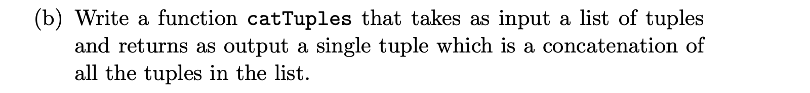
Question 3B
Some people misunderstood what was wanted here:
Input should be a list of tuples, e.g. [(2,3),(4,5),(“what”,12)]
Output should be the concatenation of these tuples: e.g. (2,3,4,5,”what”,12)
def catTuples(listoftuples):
newtuple=()
for t in listoftuples:
newtuple = newtuple + t
return newtuple

Slide 8
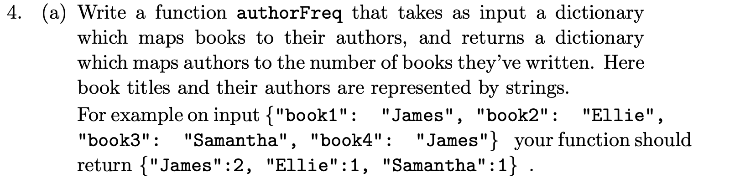
Question 4a

Slide 9
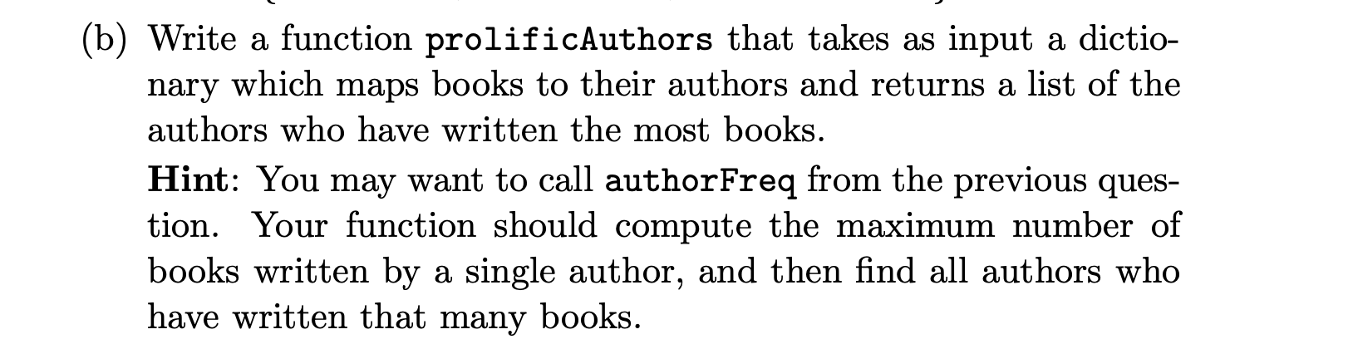
Question 4b

Slide 10
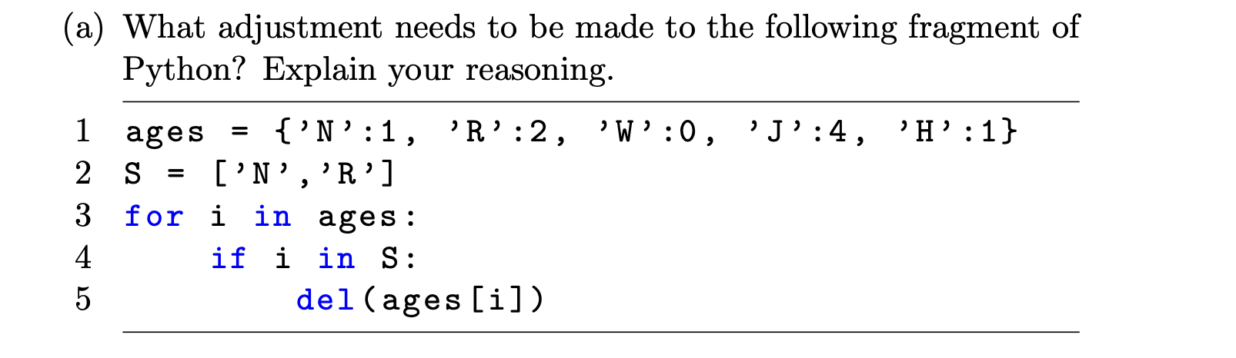
Question 5A
This code is clearly designed to delete “N” and “R” from the dictionary ages. But what actually happens?
How do we fix it?
Need to iterate over some kind of copy of ages e.g. list(ages), ages[:],

Slide 11
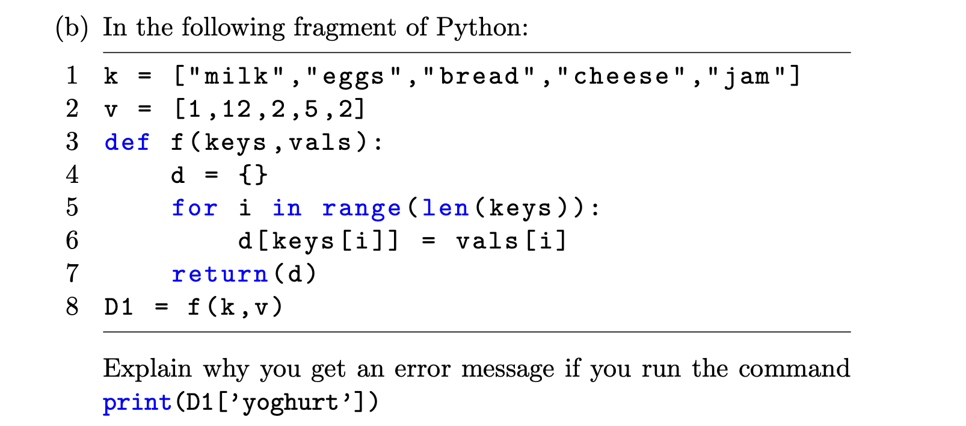
Question 5B
You get an error because the dictionary D1 has no key “yoghurt” in it

Slide 12
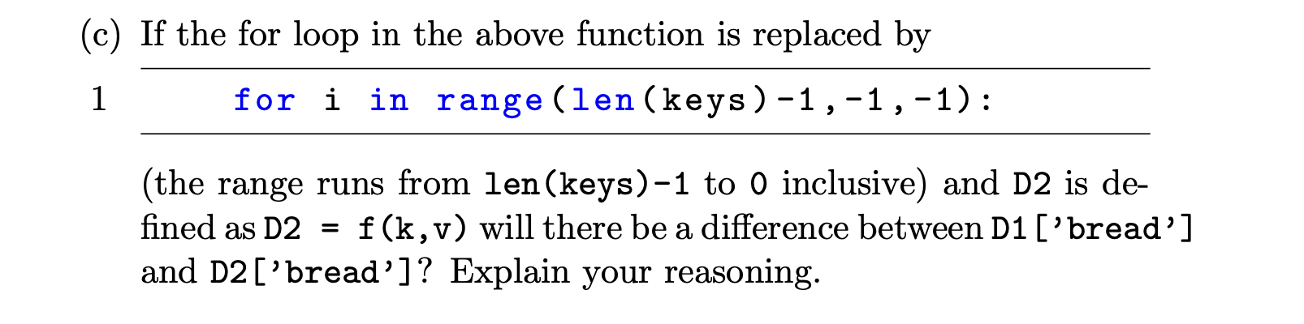
Question 5c
There is no difference between D1 and D2.
We’ve added the same (key,value) pairs to the dictionaries D1 and D2, just in a different order.

